Slide 1
Deep learning enabled smart mats as a scalable
floor monitoring system
Sarwan Ali (Ph.D.)

Slide 2
Table of Content
Introduction
Existing Solutions
Real World Applications
Proposed Solution
Data Collection
Data Analysis
Results
Demo

Slide 3
Introduction
Floor as one of our most frequently interactive interfaces that can be implemented with embedded sensors to extract abundant sensory information without the video-taken concerns

Slide 4
Existing Solutions
Camera based surveillance
Laser beam scanning
Problems:
Small scale
High implementation cost
Large power consumption
Complicated device configuration
Block by other objects

Slide 5
Solution
Deep learning-enabled smart mats (DLES-mats): Smart floor monitoring system through the integration of self-powered triboelectric floor mats and deep learning-based data analytics
The floor mats are fabricated with unique “identity” electrode patterns using a low-cost and highly scalable screen printing technique
Enabling a parallel connection to reduce the system complexity and the deep-learning computational cost
The stepping position, activity status, and identity information can be determined according to the instant sensory data analytics
Advantages of floor sensing technology:
Low-cost
Large-scale
Self-powered
Notes:
The triboelectric effect is a type of contact electrification on which certain materials become electrically charged after they are separated from a different material with which they were in contact.

Slide 6
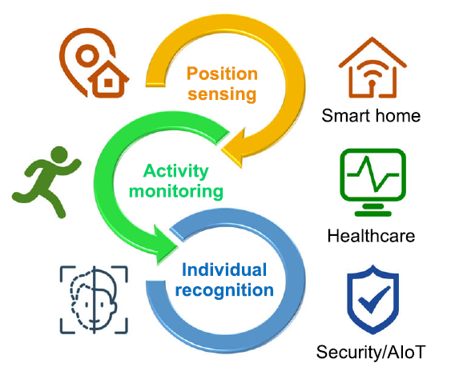
Real World Applications
Intelligent automation
Home automation of air conditioning/lighting
Security monitoring
Healthcare
Aspect of elderly people nursing (e.g., fall detection by monitoring the irregular output signals in the time domain—abnormal outputs in a short period followed by no outputs)

Slide 7
Triboelectric sensors
Triboelectric sensors can produce self-generated electrical signals based on the coupling effect of contact electrification and electrostatic induction
It show superior merits of simple configuration, great manufacturing compatibility, high scalability, no material limitation, and low cost

Slide 8
Proposed Approach
A distinct electrode pattern with varying coverage rate is designed for each DLES-mat
This mimics the unique identification of the QR (quick response) code system
With the parallel connection in an interval scheme, minimal two-electrode outputs with distinguishable and stable characteristics for the whole DLES-mat array can be achieved
Based on the relative magnitude of output signals, indoor positioning and activity monitoring can be performed
With the integrated DL-based data analytics, identity information associated with walking gait patterns can be extracted from the output signals using the convolutional neural network (CNN) model

Slide 9
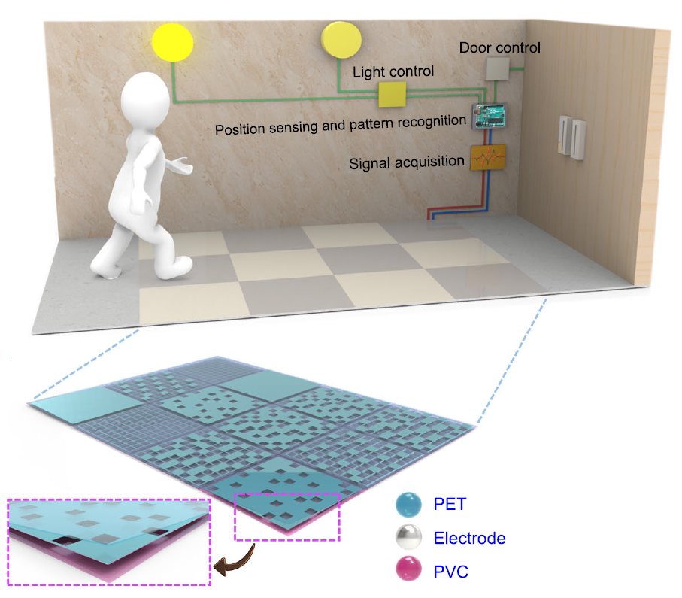
Electrode patterns are printed on a polyethylene terephthalate (PET) film and further packaging with another polyvinyl chloride (PVC) film.

Slide 10
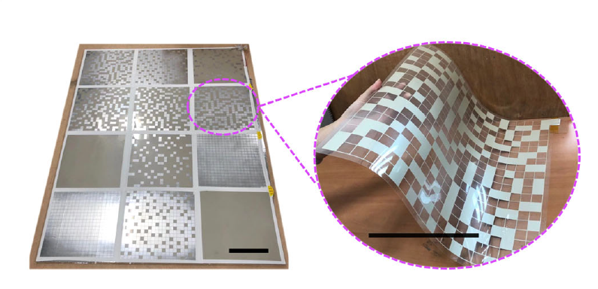

Slide 11
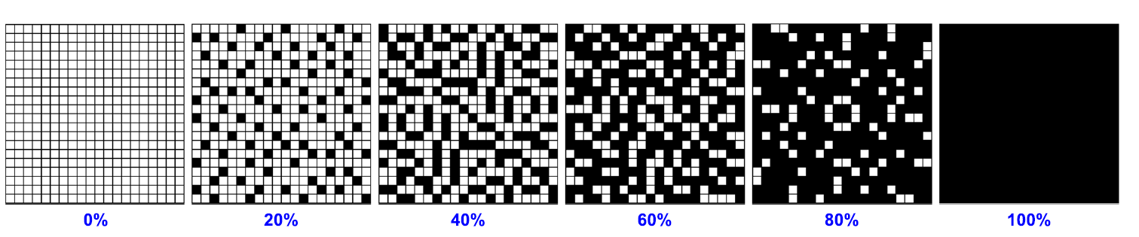
Electrode Coverage Area
The triboelectric sensors with different electrode areas generates outputs of different magnitudes, proportional to the effective induced charges on the electrode, making them distinguishable in a parallel connection
The detailed electrode layout of the floor mats with different electrode coverage rates from 0 to 100% to achieve distinguishable signal patterns after parallel connection
Black color represents the printed Ag electrode

Slide 12
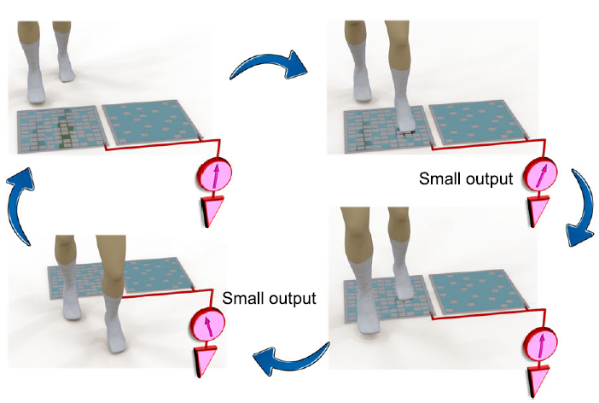
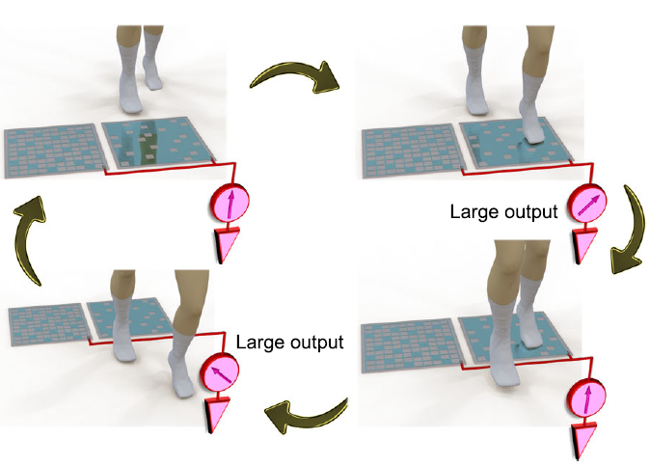
Data Collection Example
Small Electrode Coverage Area (output signal of small magnitude)
Large Electrode Coverage Area (output signal of large magnitude)

Slide 13
Working
Since the PET friction layer adopted here is relatively positive, most common materials (e.g., socks and shoe soles) become negatively charged after contacting with it, leaving its surface positively charged
When a person steps on the DLES-mat with less electrode coverage rate, a certain amount of electrons will be repelled to flow through the external circuit to the ground until new electrostatic equilibrium is achieved
Note: The amount of flowing electrons is proportional to the electrode coverage area
Stepping on the DLES-mat with less electrode coverage rate generates a smaller output current/voltage pulse
When the person steps off the DLES-mat, the same amount of electrons flow back to the electrode from the ground, generating a reverse current/voltage pulse in the external circuit.
The generated triboelectric signals with different relative magnitudes can be adopted to distinguish the outputs from different DLES-mats and determine the corresponding walking positions as well

Slide 14
Data Collection
The output from each floor mat (with different coverage area) is first characterized with repeated stepping motions by both the right foot and the left foot wearing shoes with polytetrafluoroethylene (PTFE) sole in four directions (i.e., N, north; E, east; S, south; W, west)

Slide 15
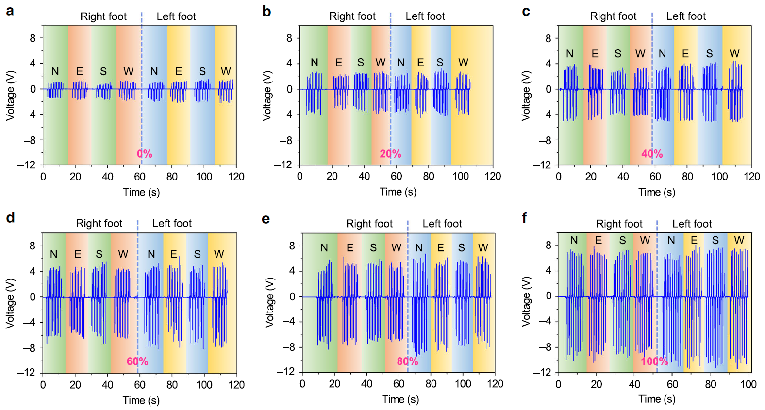

Slide 16
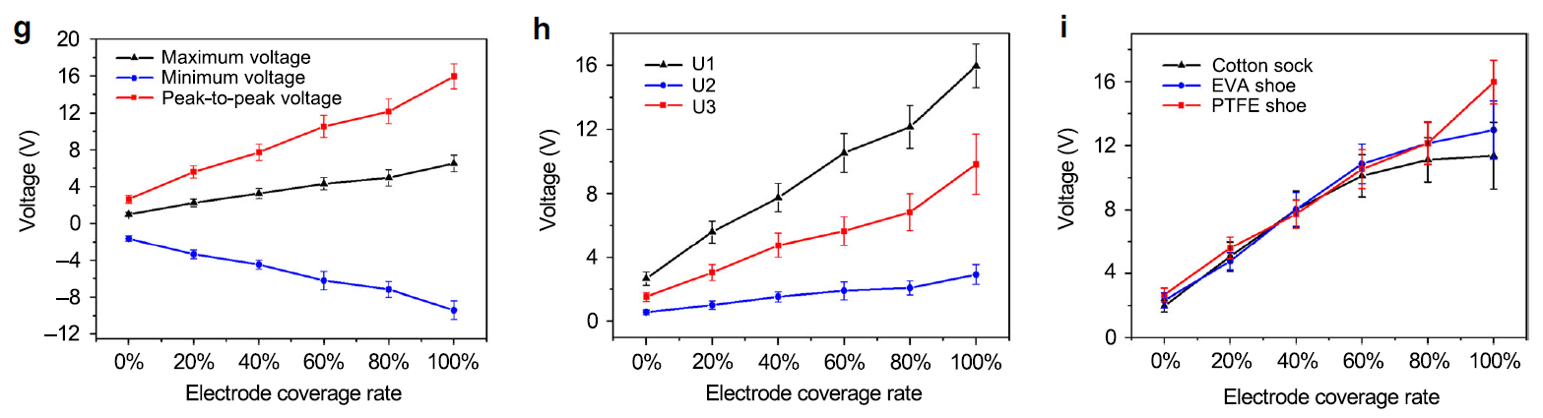
The average output trends of the maximum voltage, minimum voltage, and peak-to-peak voltage
The effect of different users wearing PTFE shoes on the output performance is investigated
The effect of different contact materials through the same user wearing different materials, i.e., cotton sock, ethylene vinyl acetate shoe, and PTFE shoe
Notes:
Peak-to-peak voltage is the distance from the lowest negative amplitude, or trough, to the highest positive amplitude, or crest

Slide 17
Data Collection (Contd.)
With the unique electrode pattern associated with each DLESmat, they can be connected in parallel to effectively reduce the number of output electrodes
Although clear differentiation can be achieved when stepping on the individual DLES-mat, the performance of the DLES-mat array under subsequent walking motions still needs further investigation.

Slide 18
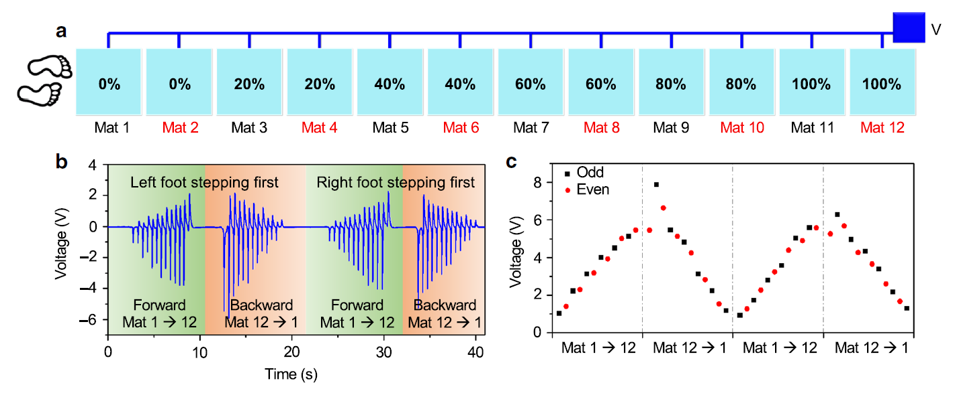
PTFE is adopted as the contact material

Slide 19
Data Collection (Contd.)
The resultant voltage trend is still unsatisfactory, with a clear deviation from the ideal increment–decrement trend
This deviation is caused by the overlapping of two opposite voltage pulses from two simultaneous stepping motions, i.e., a negative pulse from stepping on the next DLES-mat and a positive pulse from stepping off (leaving) the previous DLES-mat
To improve the signal stability of the detected output voltages, an interval parallel connection is implemented

Slide 20
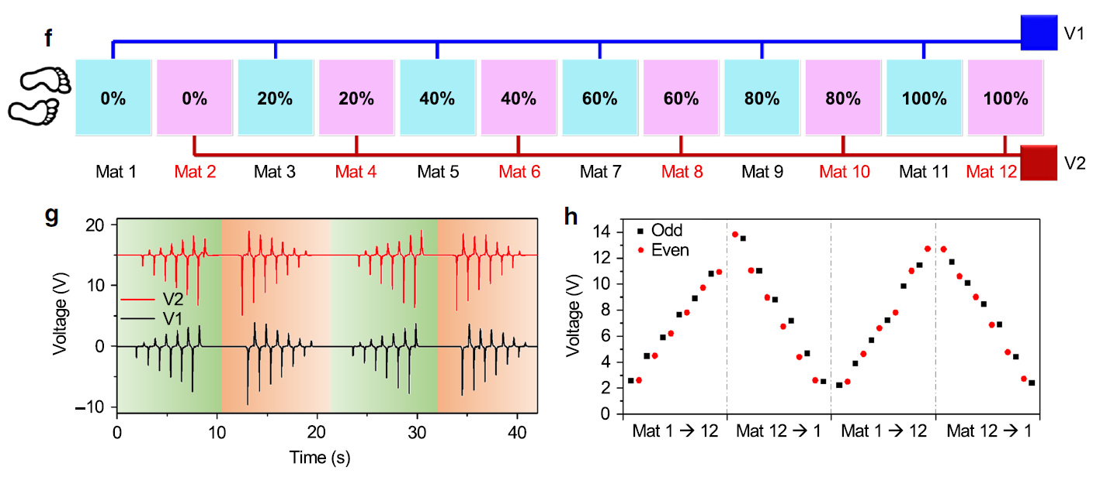

Slide 21
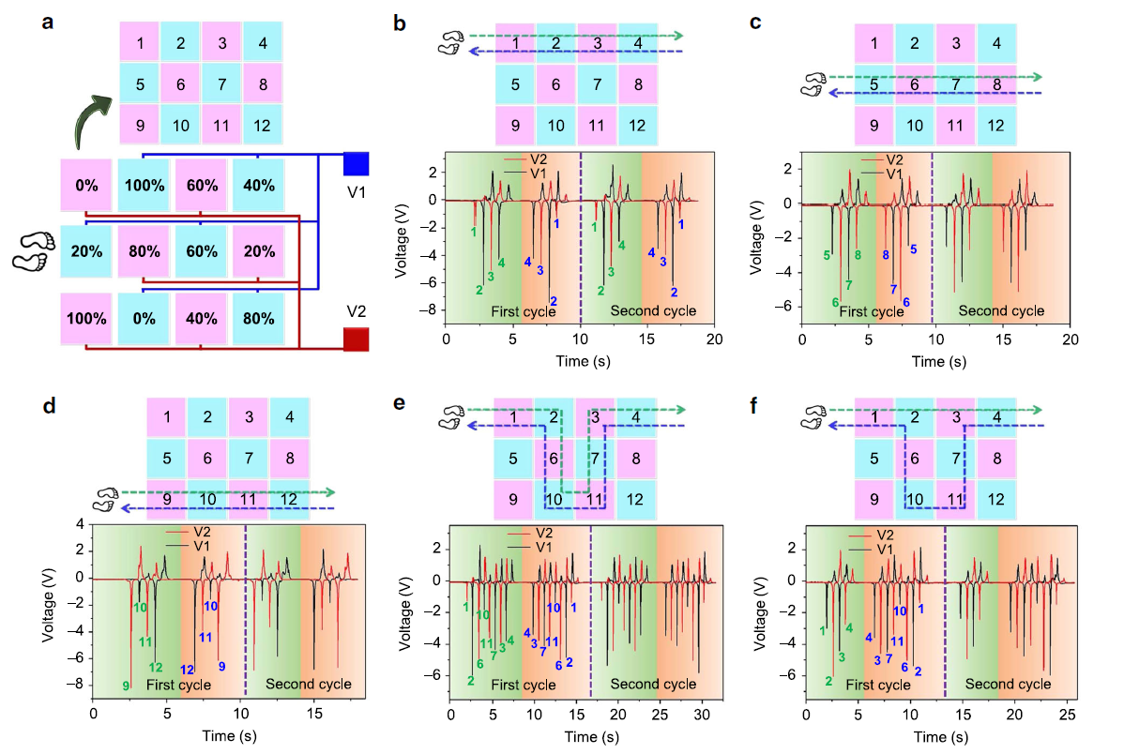

Slide 22
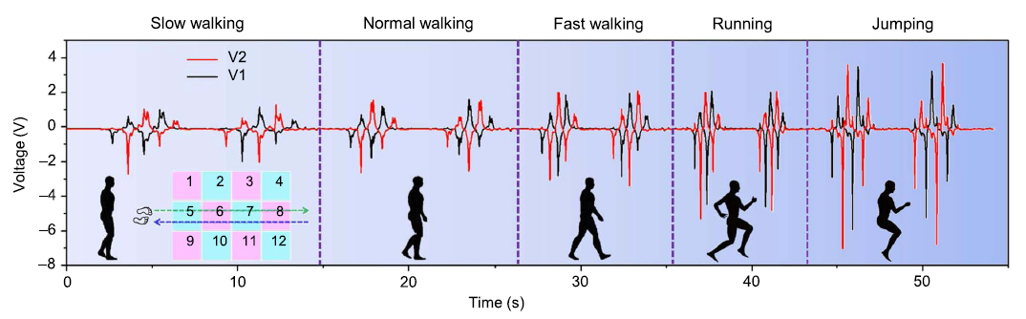
Activity monitoring and potential energy harvesting from our daily activities can be done
Different types of activities can be easily distinguished based on the overall magnitude and time period (frequency) of the output signals, indicating the activity monitoring capability
Can be applied for potential healthcare applications in exercise monitoring, including:
The type of exercises
The time period of the exercise
The burned calories based on the type and period of the exercise

Slide 23
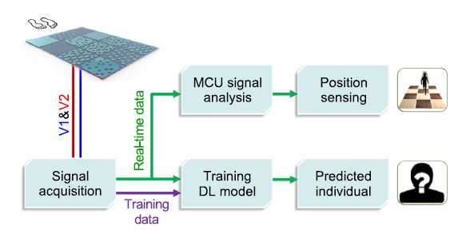
DL-based Data Analytics
When a person is walking through the DLES-mat array, triboelectric output signals are generated by the periodic contact–separation motions of human steps
These generated signals are then acquired by the signal acquisition module in an Arduino MEGA 2560 microcontroller
In terms of the training data for individual recognition, the signal data from each channel is recorded with 1600 data points (2 channels in total) and 100 samples are collected for each user (80% for training and 20% for testing).
A whole dataset is built from 10 different users, with a total number of 1000 samples (1000 x 1600 dimensional matrix)

Slide 24
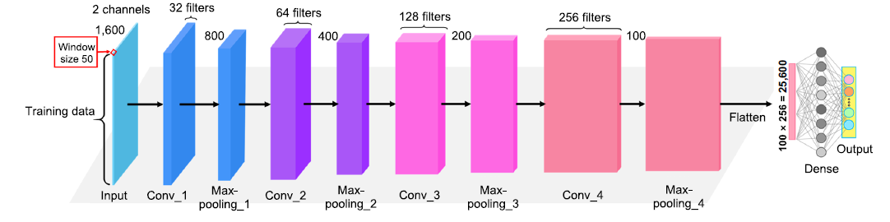
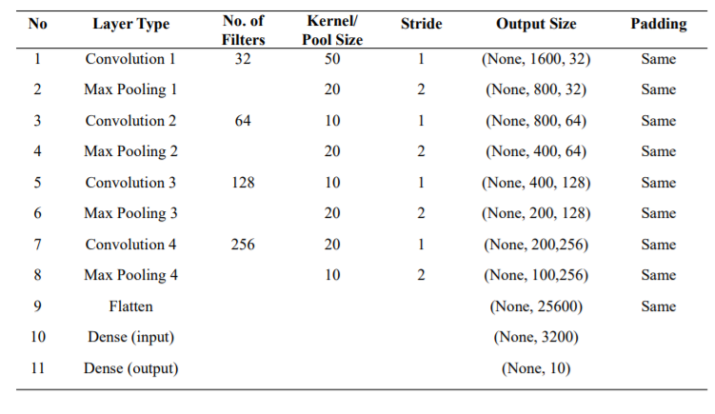

Slide 25
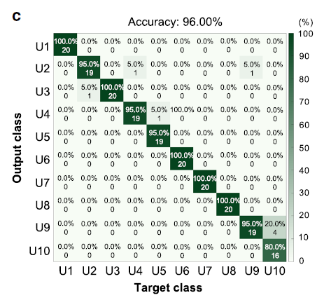
Results

Slide 26
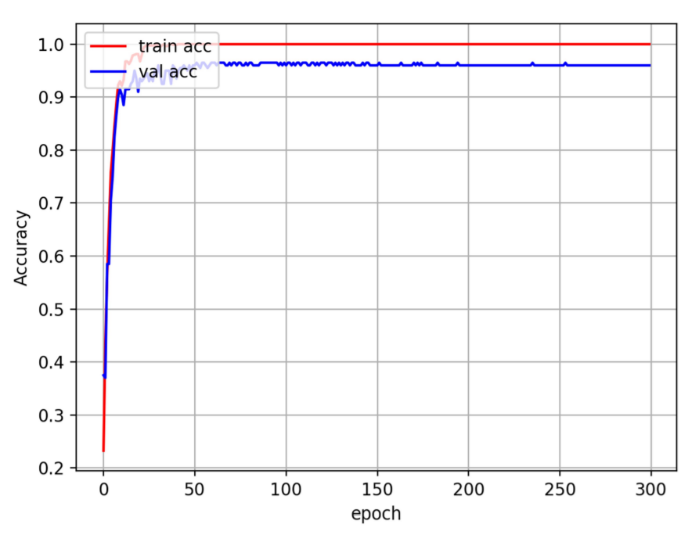
Results (Contd.)

Slide 27
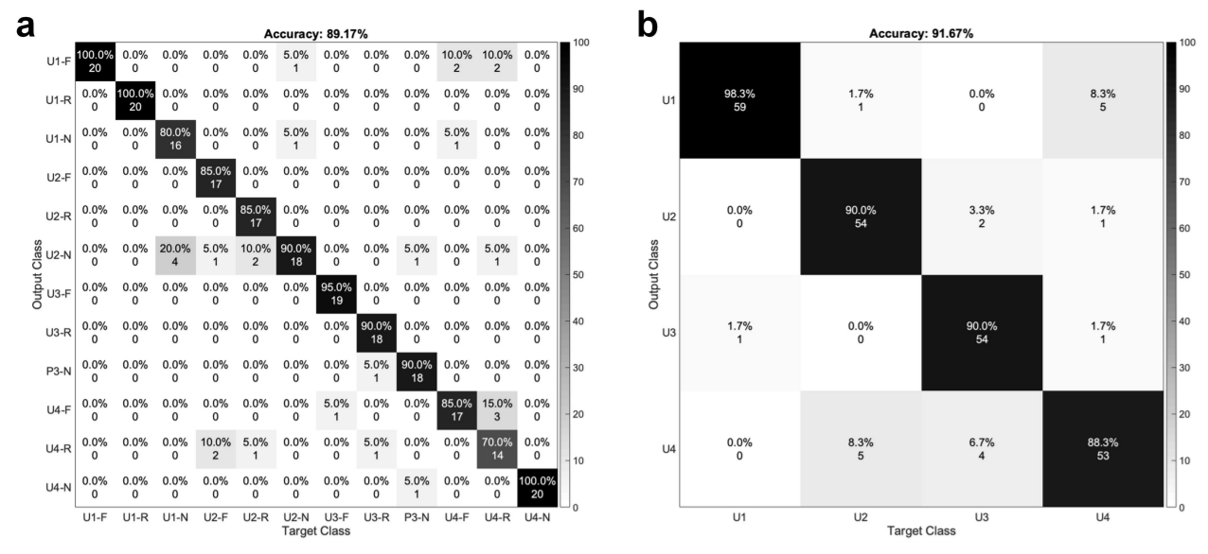
Results (Contd.)
Known passing status (N, normal walking; F, fast walking; R, running)
Unknown passing status

Slide 28
Cost estimation of the fabricated DLES-mats
The actual cost for one set of the DLES-mats (including 0%, 20%, 40%, 60%, 80%, and 100% mats) is about US$28.7
Hence the average cost for one DLES-mat with a large sensing area of 40 cm 40 cm is around US$4.8

Slide 29
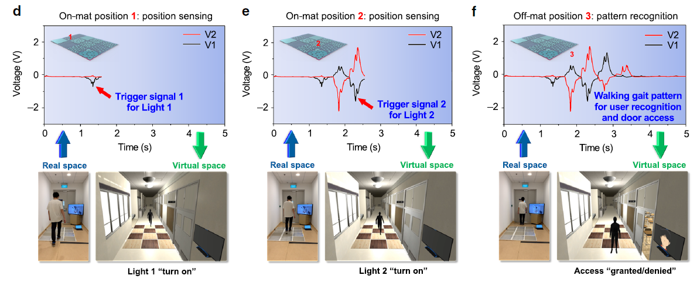
Arduino MEGA 2560 microcontroller
Signals are sent to a laptop by USB cable communication
Processing in python for peak detection and pattern recognition
Signals are sent to Unity 3d using TCP/IP protocol
CNN is used for used identification
When a person first steps on the DLES-mat array on Position 1, a small negative peak is generated from E1 (20% mat), which can be adopted as the trigger signal to move the digital twin to the first DLES-mat and turn on the corresponding Light 1
When the person continues walking, a large negative peak from E2 (80% mat, as the trigger signal to move the digital twin to the second DLES-mat) and a small positive peak from E1 (20% mat) are generated. Then upon stepping on Position 2, a negative peak with relatively smaller magnitude than the 80% mat is generated from E1 (60% mat), which is used as the trigger signal to move the digital twin to the third DLES-mat and turn on the corresponding Light 2
After walking through the whole DLES-mat array and reaching Position 3, a full cycle of the output signal is generated from both electrodes, reflecting the unique walking gait of the person. The full-cycle output signal is then analyzed by the trained DL model to predict whether the person is a valid user of the room. If the person is a valid user, then access to the room is granted and the door will be open

Slide 30
Movie Demo
https://sarwanpasha.github.io/41467_2020_18471_MOESM4_ESM.mp4

Slide 31
Reference
Shi, Qiongfeng, Zixuan Zhang, Tianyiyi He, Zhongda Sun, Bingjie Wang, Yuqin Feng, Xuechuan Shan, Budiman Salam, and Chengkuo Lee. "Deep learning enabled smart mats as a scalable floor monitoring system." Nature communications 11, no. 1 (2020): 1-11.

Slide 32
Questions!!

